Slide 1

Risk Assessment
Notes:
Welcome back. This session will provide a brief overview of the risk assessment process, which helps organizations and functional units within the organization identify and asses risk. Over the next few minutes, we will provide you with a brief overview of what risk is, and how the risk assessment process is important to our Internal Control Program here at SUNY.

Slide 2

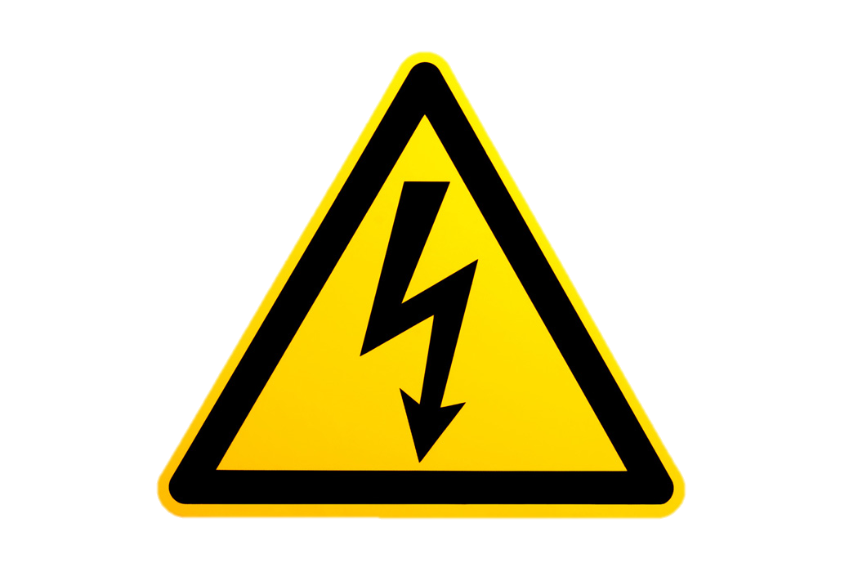

Workplace Risk
Always keep about this distance between text and the edge of slides and other content.
Risks are anything that prevents us from reaching our goals and objectives
Risk is Everywhere!
Notes:
What do you think of when you hear the term risk? Generally, risk can be defined as anything that keeps us from what we are trying to accomplish. More specifically, it is what stands in our way from successfully achieving our goals and objectives, as well as fulfilling our overall mission. Essentially, if you have goals and objectives to fulfill, there is a high probability you will be confronted with risks to achieve them.

Slide 3
Workplace Risk
Always keep about this distance between text and the edge of slides and other content.
It can be challenging to identify risks, but you can begin by asking:
  What are our goals and objectives?
  Where are we vulnerable?
  What information is important and confidential?
  What rules and laws apply?
  What would be the public perception if something
  should go wrong?
2
Notes:
When trying to identify what risks stand in your way, you can begin by asking yourself the following questions:
What are our goals and objectives?
As a large academic system, we must determine what our departments and functional areas are trying to accomplish in fulfilling our Campuses and SUNY’s overall mission.
Where are we vulnerable?
We are not only vulnerable in the financial areas of operations. Vulnerabilities also exist on the academic side as well. For instance, access to students’ personal information or compliance with accreditation requirements are also areas that are susceptible to risk.
What information is important and confidential?
As an academic institution we have a number of items and information that we need to protect. Examples include cash, moveable equipment, student information, and our overall reputation
What rules and laws apply?
There are numerous regulations that apply to our operations. Some examples include NY state procurement laws, state and federal financial aid regulations, and NCAA requirements.
And what would be the public perception if something should go wrong?
Our reputation would be negatively impacted and impact our success.
Answering these questions will help identify what risks exist within your functional area. Some are obvious, while others may require you to dig deeper to find them.

Slide 4
Workplace Risk
Reputational
Public Perception
Always keep about this distance between text and the edge of slides and other content.
Financial
Loss of Assets
Compliance
Laws, regulations, policies, and procedures
Operational
On-going processes
3
Notes:
There are several categories of risk that exist and they can be either internal or external in nature:
Compliance risks are those that can prevent us from complying with the various laws, regulations, policies and procedures that govern a particular functional area. As a New York State entity, we are subject to a number of regulations in addition to the federal laws that govern the higher education industry. There are also accreditation standards that each of our campuses must comply with in order to ensure we continue providing quality education to our students.
Operational risks affect ongoing management processes. Each department is responsible for completing a set of specific functions in order to help achieve our objectives. There are a variety of issues that could occur to prevent us from successfully carrying out these functions. This could include employees suddenly quitting, a breakdown in machinery, or a data server crashing unexpectedly.
Financial risks are those that result in a loss of assets. These can be closely associated with fraudulent activity (such as employee theft), bad investments, or misappropriations.
Reputational risks can negatively impact SUNY’s reputation or brand name. For instance, negative stories about SUNY in the press could prevent students from wanting to attend one of our campuses. Depending on the severity, failure to achieve our operational, compliance and/or financial goals could all have an impact on our overall reputation in the higher education industry.

Slide 5
Risk Assessment
Regularly assess risks that could prevent you from meeting objectives
Identify and assess changes that could significantly impact internal control
Consider the potential for fraud and use of IT when assessing risks
Specify objectives with sufficient clarity
Identify risks to the achievement of objectives and determine how they should be managed
Always keep about this distance between text and the edge of slides and other content.
4
Notes:
Although we can never completely eliminate risk, we can do a number of things to effectively manage risks to mitigate them to an acceptable level.
The risks to achieving objectives should be assessed on a regular basis to help ensure our success.
Formal risk assessments should be conducted on a regular basis to help ensure that we are adequately managing the risks that could prevent us from carrying out our responsibilities and achieving our objectives.
To begin a risk assessment, managers first need to document the objectives their functional unit is responsible for.
Once this is done, the next step is to determine the risks that could occur that could potentially prevent the successful achievement of these objectives.
It is important to consider the impact of internal organizational changes and external regulatory changes that might impact your department’s ability to fulfill its responsibilities.
Ultimately, you want to identify the major risks that will have the highest probability of occurring, and/or the largest impact should the risk actually occur.
As part of the Internal Control Program, we have developed templates to assist in the risk assessment process.

Slide 6
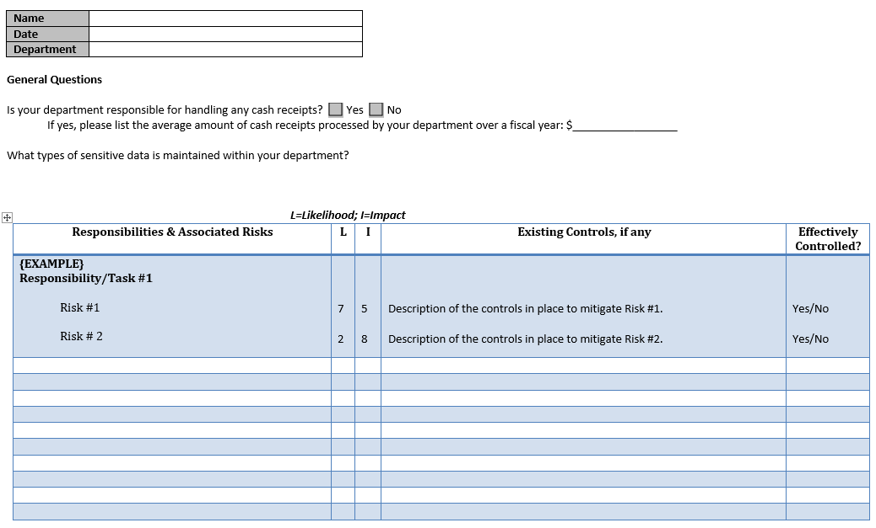


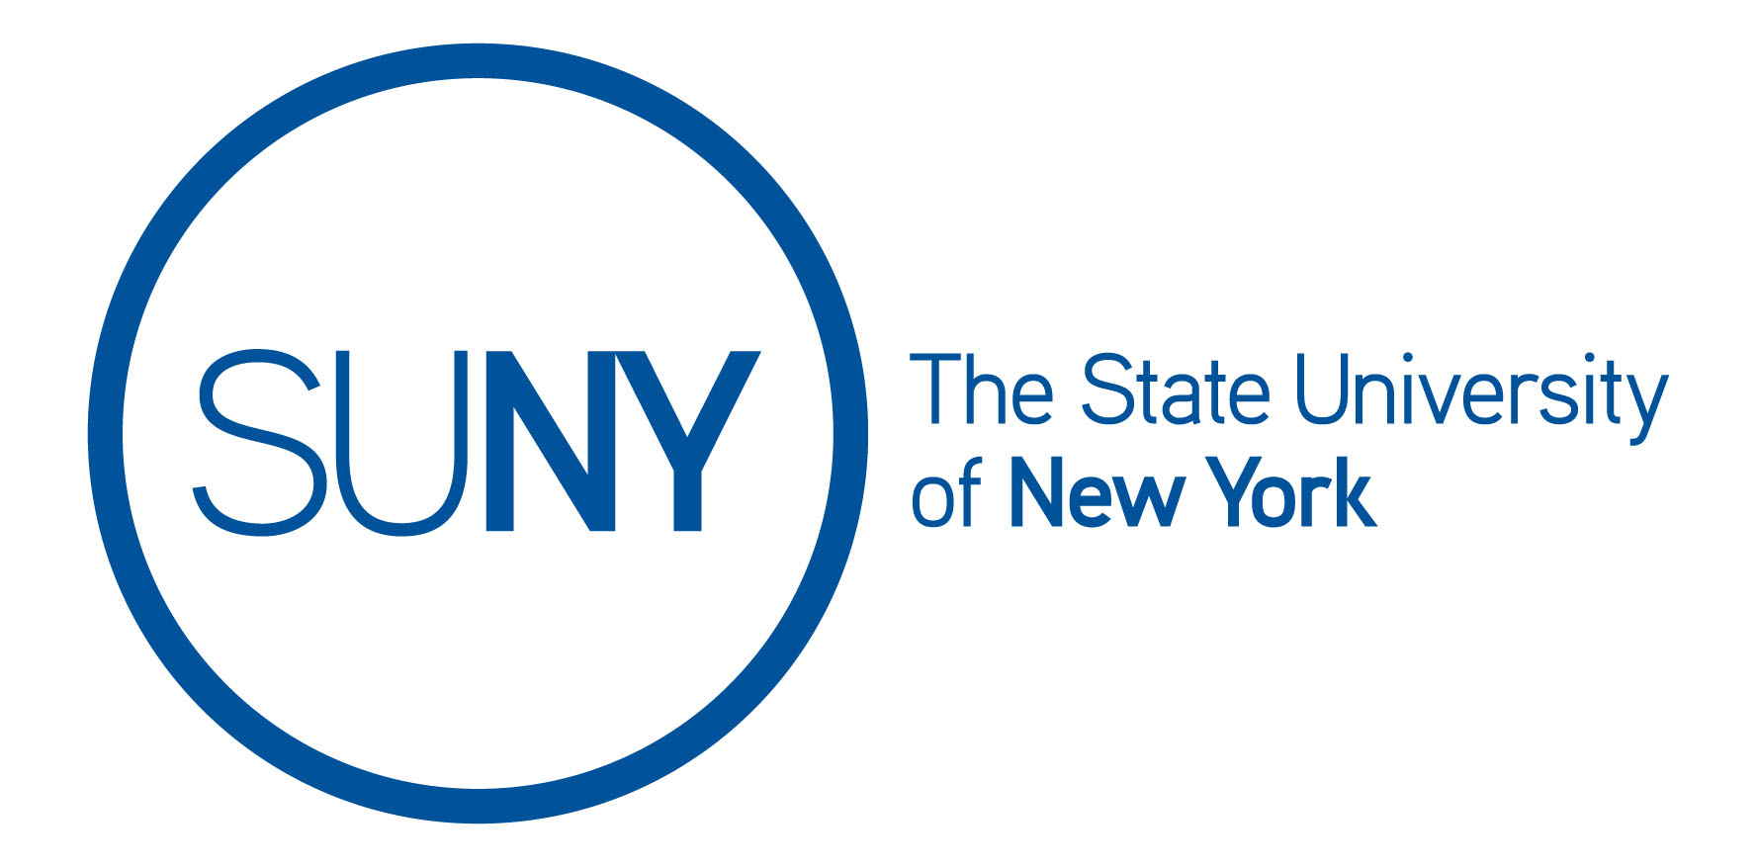
Risk Assessment
Always keep about this distance between text and the edge of slides and other content.
5
Notes:
Risk assessment templates help facilitate the process by identifying each department or functional areas responsibilities and associated risks, assessing the significance of each risk identified, and determining whether there are effective controls in place to help mitigate these risks.
The purpose is not to ensure all risks are rated as “Effectively Controlled" ,but rather to help departments or functional areas assess their control structure for sufficiency given their environment, resources, and bandwidth.
Managers should maintain their analysis and interpretation of the risk assessment and should periodically review these decisions to determine whether changes in conditions warrant a different approach to managing and reducing risk.

Slide 7
Thank You!
Created by the Office of the University Controller, SUNY System Administration
Notes:
This concludes our presentation on risk assessment. Thank you for your continued support in helping maintain effective internal controls. If you have any questions or comments, please contact your Internal Control Officer.

